Slide 1

Location tracking in 5G Network

Slide 2
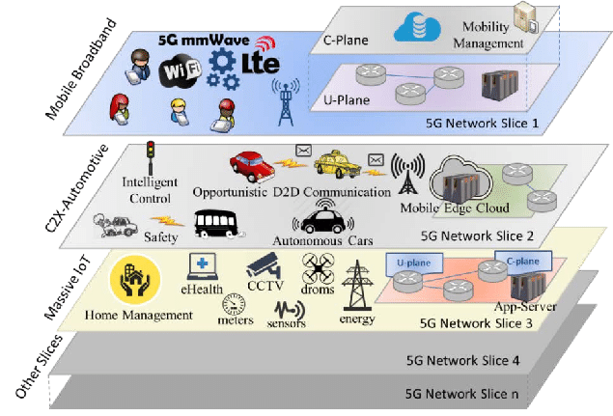
Firstly, what is 5G Network Slicing and why is it important for 5G?
A slice is a logical block in the 5G core network to serve a specific purpose like:
private networks
massive machine type communication
streaming
automotive
Mobile Virtual Network Operator (MVNO)
Network slicing allows a mobile operator to divide their network and provide different amounts of resources and prioritization to different types of traffic.
Click here to add content of the text，and briefly explain your point of view
Click here to add content of the text，and briefly explain your point of view
Source: https://www.researchgate.net/figure/5G-network-slices-structure_fig4_301799845

Slide 3
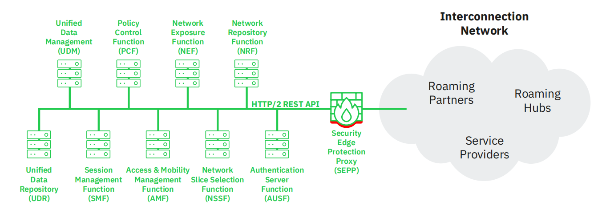
Service Based Architecture (SBA) and Slicing
A slice in the core network consists of a group of Network Functions (NFs) that support that slice.
The 5G standards introduced a new architectural concept called the Service Based Architecture (SBA).
Network function(NF) can:
-> offer a service and so be a service producer
-> act as a service consumer when it requests a service from another network function
It allows fast and easy integration of new network services and brings telecommunication
networks’ approach to design closer to that of IT-networks.
Source: https://info.adaptivemobile.com/5g-network-slicing-security

Slide 4
Authentication and Network Repository Function (NRF) in SBA
As mentioned before, in SBA each network function can contact every other network function, but this is authenticated somehow, for this we need a Network Repository Function.
The NRF is defined by 3GPP and it offers three main services:
Network Function Management:
let network function instances in the same network to register, update and de-register their profile in the NRF
Network Function Discovery:
let network function to discover the services of other network function instances in the same network querying an NRF in another network on behalf of a network function
OAuth2 Authorization service:
issues a token to a requesting NF and prove that it is authorized to consume the service of another network function
Enter title
Enter title
Enter title

Slide 5
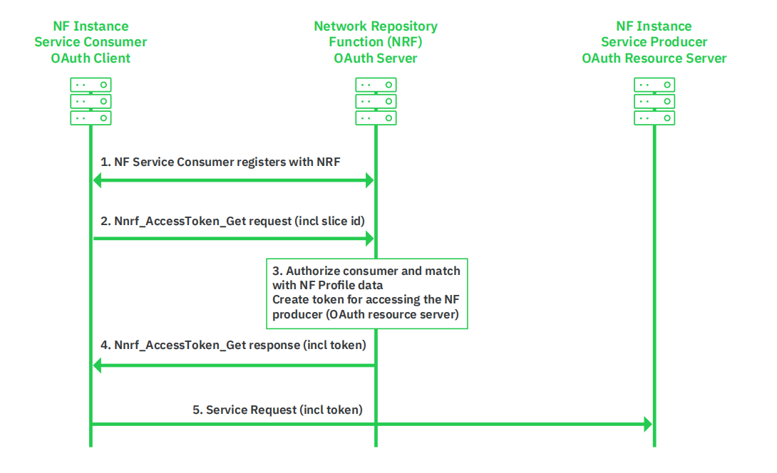
How authentication works
An important aspect that should be mentioned is that the authentication is made based on the slice identity information given by the NF consumer to the NRF.
There is no other cross-check to confirm the fact that the slice identity presented by the NF consumer truly belongs to this NF consumer.
Source: https://info.adaptivemobile.com/5g-network-slicing-security

Slide 6
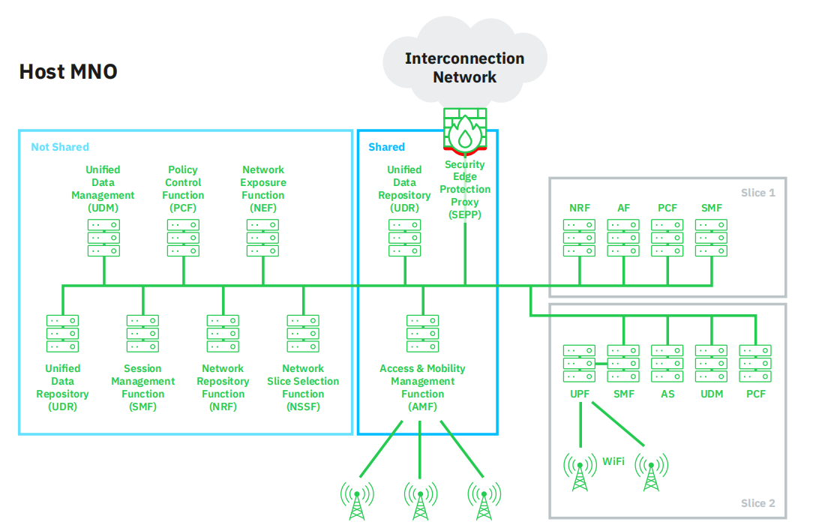
Shared NF between two slices
Source: https://info.adaptivemobile.com/5g-network-slicing-security

Slide 7
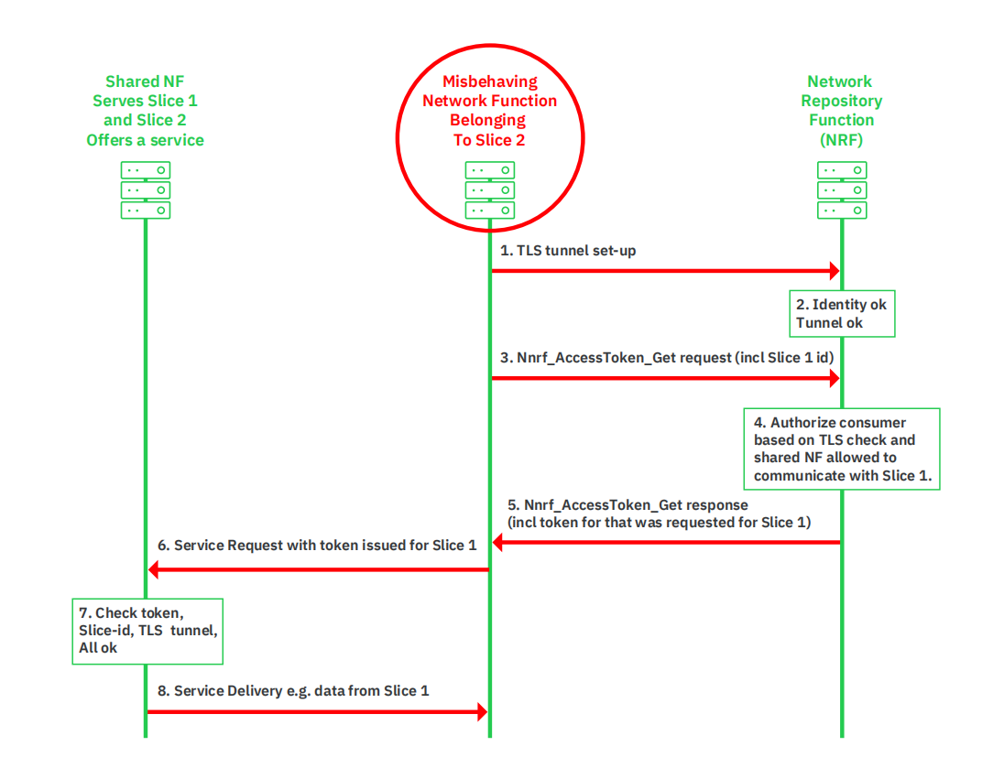
Malicious Access to Different Slice
Establish a TLS connection to NRF
Check identity.
Request a token to access Slice 1 on the shared NF. This request would contain a slice identity “Slice 1”.
NRF check if the NF is allowed to be accessed.
A valid token for Slice 1 and the shared NF would be generated.
NF from Slice 2 would present to the shared network function the token for Slice 1
NF from Slice 1 will get a valid token and will grant access for NF from Slice 2.
The service would be delivered.
Source: https://info.adaptivemobile.com/5g-network-slicing-security

Slide 8
thank you

